Slide 1
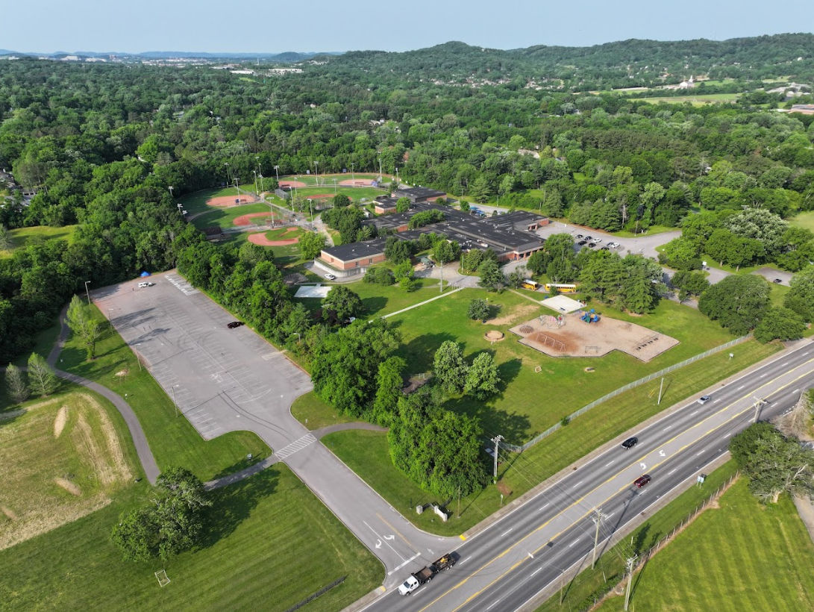
Civitan Park
Lipscomb Elementary
Main parking for game days/nights
Concord Rd
8013 Concord Rd

Slide 2
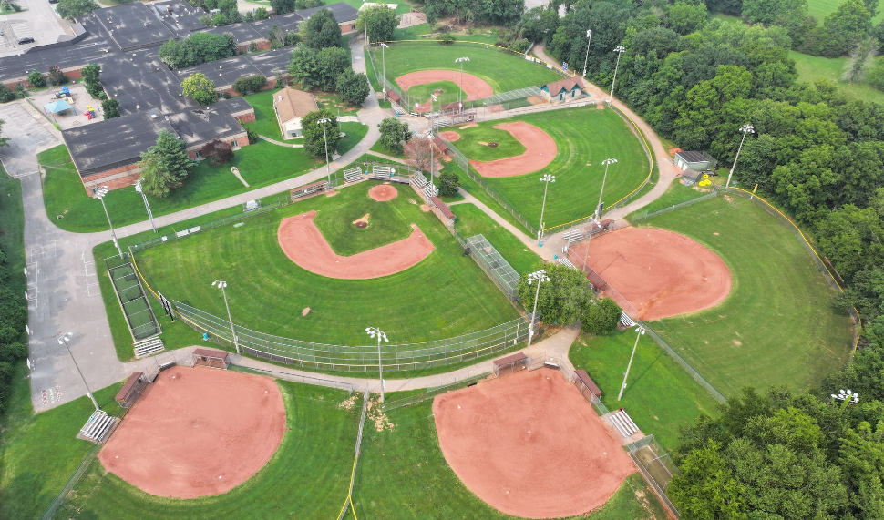
Lipscomb Elementary School
Clubhouse/Concessions
Field #1
Bathrooms
Pitching Cages
AED
Field #2
Field #3
Field #6
Batting Cages
Batting Cages
Field #5
Field #4

